Slide 1
SNS ACADEMY
A fingerprint International School
Affiliated to CBSE New Delhi
Affiliation No :1930610
GRADE XII B (2020-21
COURSE NAME : ECONOMICS (030)
Chapter 8
INFRASTRUCTURE

Slide 2
GDP OF INDIAN STATES IN 2019
Maharashtra ₹32.24 lakh crore
Tamil Nadu ₹20.91 lakh crore
Gujarat ₹18.85 lakh crore
Karnataka ₹18.05 lakh crore
WHAT IS THEIR PERCAPITA INCOME RANKING?
WHY ??

Slide 3
BETTER INFRASTRUCTURE
TRANSPORT
IRRIGATION
EDUCATION
Infrastructure refers to core elements of economic & social change which serve as a support system to production activity in the economy.
Economic infrastructure is the elements of economic change like- power, transport, communication etc. which serve as a support system to the process of economic growth. It fosters economic growth which results in increase in the standards of living of the people.

Slide 4
social infrastructure refers to core elements of social change like- schools, colleges, hospitals, banking etc. which serve as a support system to the process of social development of a country. social infrastructure focuses on human resource development, implying the development of skilled personal as well as healthy & efficient human beings. It accelerate the process of human development.

Slide 5
Better infrastructure leads to Economic Development and good standard of living
Better health facilities and less pollution reduces morbidity.
Government alone cannot take the responsibility of infrastructural development, so private sector also contributes to it.
Life of rural region becomes harder due to less infrastructure.
They use bio fuel, walking for transport, well water etc
Infrastructure is the foundation of development,

Slide 6
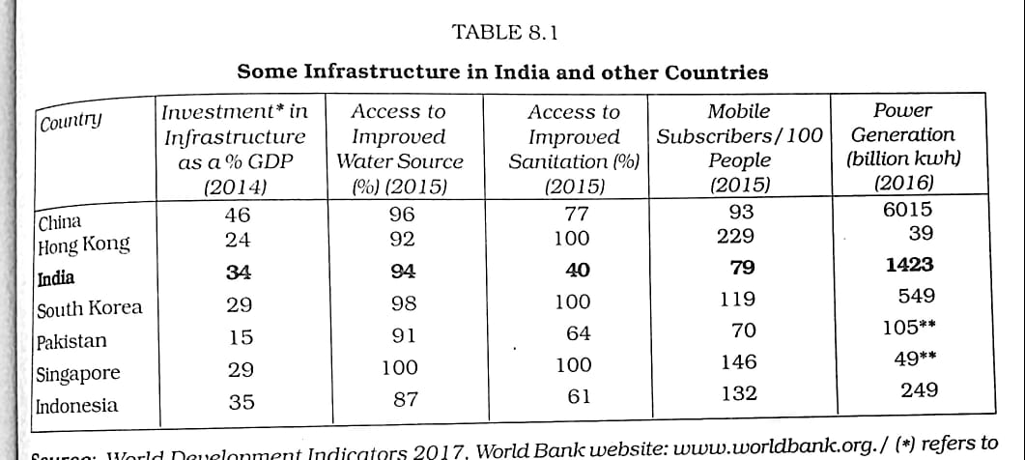
CONTENT SLIDE

Slide 7
HEALTH
It is a state of complete physical, mental & social well-being. A persons ability to work depends largely on his good health. It enhances the quality of life.
Health infrastructure includes hospitals, doctors, nurses and other para-medical professionals, beds, equipment required in hospitals and a well-developed pharmaceutical industry
Government should care health related issues such as medical education, adulteration of food, drugs and poisons, medical profession, vital statistics, mental deficiency and lunacy.

Slide 8
Private sector has made enormous growth in Medical field.
Medical Tourism
Health infrastructure can be upgraded to attract more foreigners to India
Ayurveda, Yoga, Unani, Siddha, Naturopathy and Homeopathy (AYUSH).

Slide 9
Challenges of Health Development
.
Unequal distribution of health services.
Control of communicable diseases.
Poor management of health care.
Privatization of health care services.
Poor upkeep & maintenance.
Poor sanitation level.

Slide 10
Global Burden of Disease (GBD) is an indicator used by the experts to measure the number of people dying prematurely due to a particular disease. This also includes the number of years spent by them in a state of disability due to various diseases. India bears a frightening 20 % of the GBD. More than half of the GBD is accounted by communicable diseases such as diarrhea, malaria etc
Women's health become a matter of great concern.

